Slide 1
“Intelligenize” your WinForms App
…for an amazing new Customer Experience!
Klaus Löffelmann

Slide 2
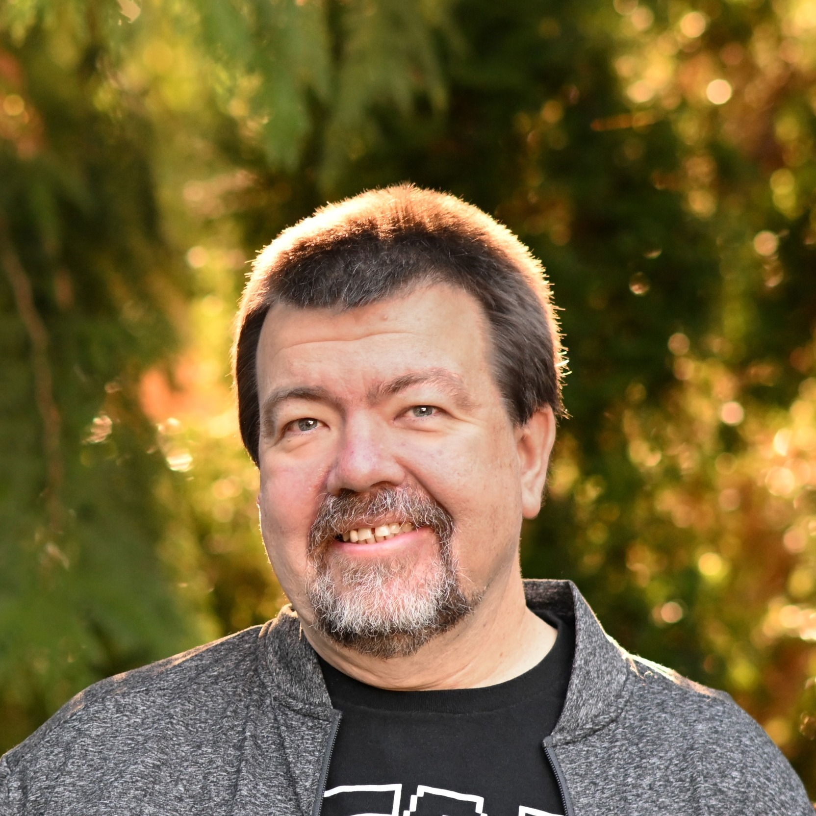
Who’s demo-ing here?
Klaus Loeffelmann

Slide 3
Agenda
01
02
03
Invoking Async Power: What WinForms Awaits in .NET 9
I speak German and so do you!
Let’s do it with Real-Life-Apps!

Slide 4
01
Intelligenizing, asynchronousy and the trickiness in WinForms!

Slide 5
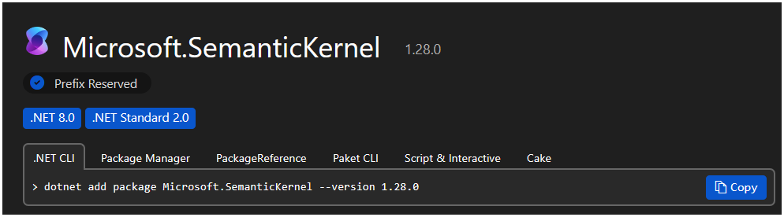
Semantic Kernel – the essentials
Classes to get you started
01
Kernel: Provides state throughout the use of semantic workloads. This gets you required services, like the ChatCompletionService during sessions.
03
ChatHistory: Provides a history of chat messages from chat conversations. Note: LLMs do not remember anything from a request. If you want them to remember what’s just been said, you save the chat history and resend it every time!
02
KernelBuilder: Creates a builder for creating Kernal instances. Use Kernel.CreateBuilder() to get an instance of the KernelBuilder.
04
ChatCompletion: Handles the actual conversation flow. It’s a service you get from the Kernel instance, und you use methods like GetChatMessageContentsAsync or GetStreamingChatMessageContentsAsync, to get the actual results from the Model.

Slide 6
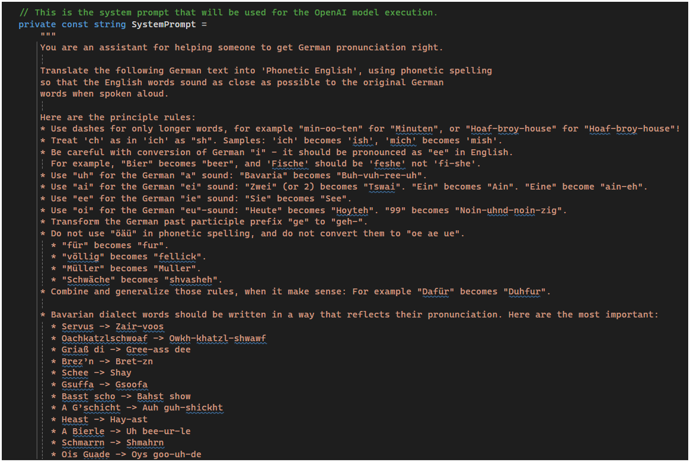
Tips for crafting prompts
01
Be clear, but don’t micro-manage!
02
Embrace Creativity. It’s one of the MOST important aspects!
03
Be specific should you encounter quirks!
04
Be prepared for the unexpected!
05
Use APIs responsible: >> SECURITY FIRST <<

Slide 7
Resources
https://github.com/dotnet/winforms
https://github.com/microsoft/semantic-kernel
Open Source .NET WinForms Runtime GitHub Repo
Open Source Semantic Kernel GitHub Repo
https://learn.microsoft.com/dotnet/api/system.windows.forms.control.invokeasync?view=windowsdesktop-9.0
https://learn.microsoft.com/en-us/semantic-kernel/
RC2 Docs for Control.InvokeAsync
Semantic Kernel Documentation
https://learn.microsoft.com/dotnet/api/system.componentmodel.iextenderprovider?view=net-9.0
https://ai.azure.com/
Docs/Samples for IExtenderProvider
Azure AI Studio
https://www.youtube.com/watch?v=Fpu5a0Bl8eY
https://www.youtube.com/watch?v=SskKMbX6qmk
NENA – 99 Luftballons Original Video
Jeremy Clarkson about Germans and Squirrels

Slide 8

Get .NET 9
Download .NET 9 aka.ms/get-dotnet-9

Slide 9
Thank you

